Slide 1
RDF Schema
Mauricio Espinoza Mejía
mauricio.espinoza@ucuenca.edu.ec

Slide 2
Content
RDF and RDF Schema
RDF Schema
The language
Some more RDF(S)
RDF vs. RDFS layers

Slide 3
RDF and RDF Schema
Consider the RDF document
ex:Karina rdf:type ex:Assistant .
ex:Mauricio rdf:type ex:Professor .
ex:SemanticWeb rdf:type ex:Module .
ex:SemanticWeb ex:isTaughtBy ex:Karina .
How can we collect all academicStaff members?
What about − professors are academic staff members
We need statements not only about individual objects (such as Karina, Mauricio) but also about classes of objects (such as professors, academic staff, etc.)

Slide 4
RDF Schema
RDF Schema ‘semantically extends’ RDF to enable us to talk about classes of resources, and the properties that will be used with them.
Classes in RDF Schema is much like classes in object oriented programming languages. This allows resources to be defined as instances of classes, and subclasses of classes.

Slide 5
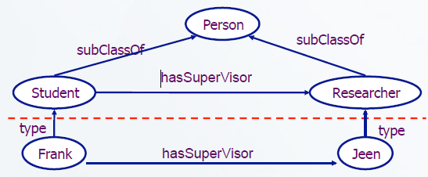
RDF Schema: the language
rdf:type, which relates resource to its class (the resource is declared to be an instance of that class)
rdfs:subClassOf, allows to declare hierarchies of classes
all instances of a class are instances of its superclass
note that a class may be a subclass of more than one class

Slide 6
RDF Schema: the language
rdfs:subPropertyOf, which relates a property to one of its superproperties
rdfs:domain of an rdf:predicate declares the class of the subject in a triple.
rdfs:range of an rdf:predicate declares the class or datatype of the object in a triple.

Slide 7
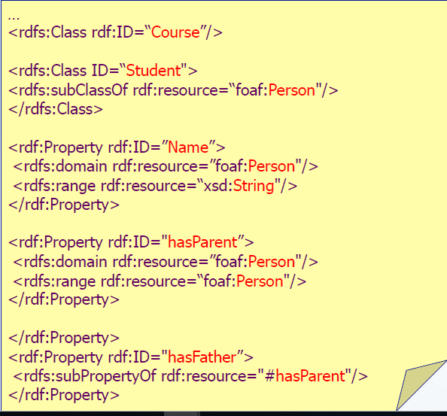
RDF Schema Sample

Slide 8
Some more RDF(S)
rdfs:label is used to indicate a resource that might provide additional information about the subject resource
– ex:Town rdfs:label “Town”
rdfs:comment may be used to provide a human-readable description of a resource.
– ex:Town rdfs:comment “A town is smaller than a city”
rdfs:seeAlso is used to indicate a resource that might provide additional information about the subject resource
– ex:Town rdfs:seeAlso ex:City

Slide 9
Example
professors are academic_staff_members
modules are taught by academic staff members only
Is taught by is a subproperty of involves
Semantic Web is a module and Michael Zang is a proffesor

Slide 10
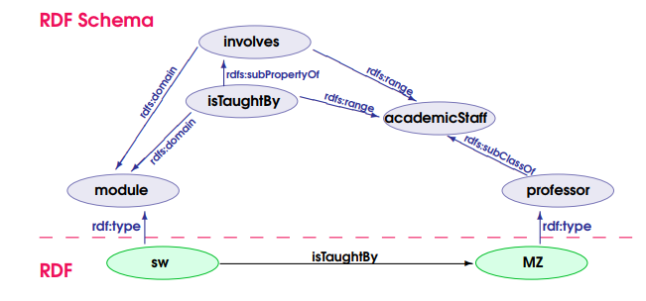
RDF vs. RDFS layers
What ‘implicit knowledge’ is missing in the picture

Slide 11
Práctica 10

Slide 12

Preguntas?

